Slide 1
Mobile Technologies
The Past, Present and Future
Alex Bradley

Slide 2
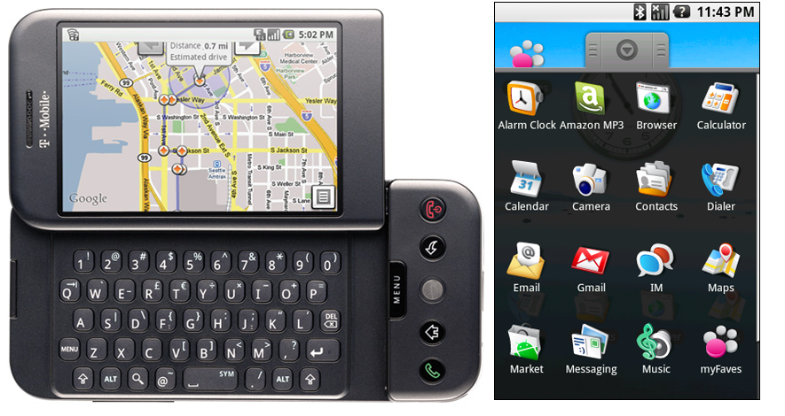
The Past
Android 1.0
Notes:
It started in 2008 on the T-Mobile G1.
This was launched in the US with very basic features.
This version started with a basic but flawless notification system.

Slide 3

The Past
Android 1.5 (Cupcake)
Notes:
The first fully available android version was cupcake released in April of 2009, only six months after Android 1.0.
This versions main feature was a fully touchscreen keyboard that was usable on screen
The HTC magic became the first fully touchscreen phone on the market
Other features included video capture as well as playback on the screen
Image from: http://tech.firstpost.com/news-analysis/from-cupcake-to-kitkat-a-look-at-the-history-of-android-os-214967.html

Slide 4

The Past
Android 1.6 (Donut)
Notes:
The main feature of 1.6 was voice and text entry as well as an application to store and display emails.
Multi-lingual speech synthesis engine allowing android to “speak” a string of text in different languages.
Image from: http://tech.firstpost.com/news-analysis/from-cupcake-to-kitkat-a-look-at-the-history-of-android-os-214967.html

Slide 5
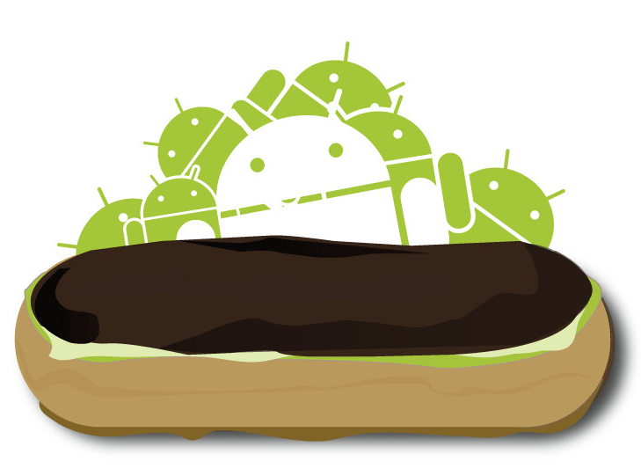
The Past
Android 2.0 – 2.1 (Éclair)
Notes:
Android had now added live wallpapers. This basically allowed the user to set video like backgrounds on their phone.
Image from: http://tech.firstpost.com/news-analysis/from-cupcake-to-kitkat-a-look-at-the-history-of-android-os-214967.html

Slide 6
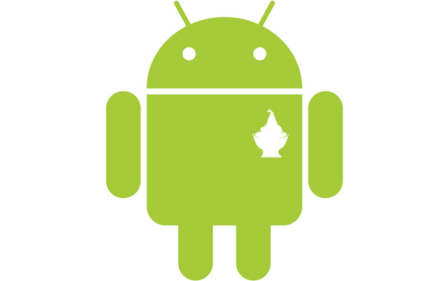
The Past
Android 2.2 (Froyo)
Notes:
Froyo was quite a big update for android. They introduced USB tethering, and Wi-Fi hotspot functionality. Both of these allowed the user to use their phone as an internet hotspot, connecting other devices that didn’t have access to the internet allowed those devices to connect to the internet.
Froyo also included the option to disable data access over mobile network, this meant that users could decide when they wanted to be able to connect to the internet outside of their home.
Image from: http://tech.firstpost.com/news-analysis/from-cupcake-to-kitkat-a-look-at-the-history-of-android-os-214967.html

Slide 7

The Past
Android 2.3 (Gingerbread)
Notes:
SIP VoIP was added which gives the phone similar capabilities to Skype.
NFC was introduced for easier transfer between android devices, a chip is placed in the back of the phone which can communicate with other NFC chips, working similarly to Bluetooth
Ability to put apps on an SD cards, saving a lot of space on the phone memory.
Image from: http://tech.firstpost.com/news-analysis/from-cupcake-to-kitkat-a-look-at-the-history-of-android-os-214967.html

Slide 8

The Past
Android 3.0 (Honeycomb)
Notes:
This particular operating system was only available for tablets.
It was built to be able to run on a tablet, but operating systems have since had both tablet and phone support.
Image from: http://tech.firstpost.com/news-analysis/from-cupcake-to-kitkat-a-look-at-the-history-of-android-os-214967.html

Slide 9

The Past
Android 4.0 (Ice Cream Sandwich)
Notes:
This was the first operating system to come with 1080p recording standard on devices
As well as the ability to unlock your phone with your face, helping security on mobile devices.
Image from: http://tech.firstpost.com/news-analysis/from-cupcake-to-kitkat-a-look-at-the-history-of-android-os-214967.html

Slide 10
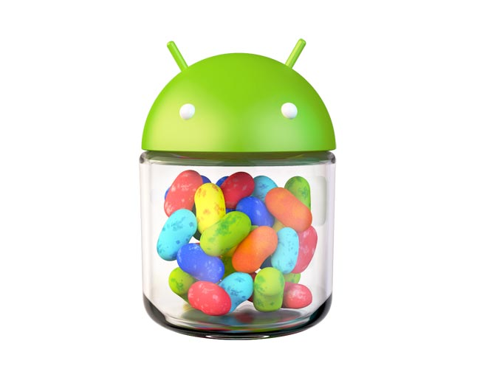
The Past
Android 4.1 (Jelly Bean)
Notes:
Jelly-Bean came with the capability to collapse all of the current running applications with one finger gestures.
This would be done by swiping a finger across the screen when viewing the applications that are currently open.
Image from: http://tech.firstpost.com/news-analysis/from-cupcake-to-kitkat-a-look-at-the-history-of-android-os-214967.html

Slide 11
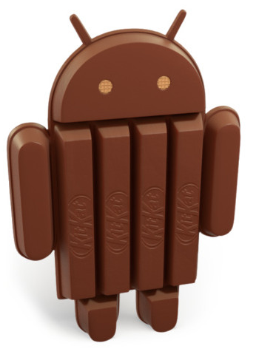
The Past
Android 4.4 (KitKat)
Notes:
This operating system was released quite a while after wireless printing was first introduced (OS: 2013, Wireless printing: 2010), however it was the first to introduce wireless printing support, allowing the user to print any documents or pages straight from their phone using an application.
Image from: http://tech.firstpost.com/news-analysis/from-cupcake-to-kitkat-a-look-at-the-history-of-android-os-214967.html

Slide 12
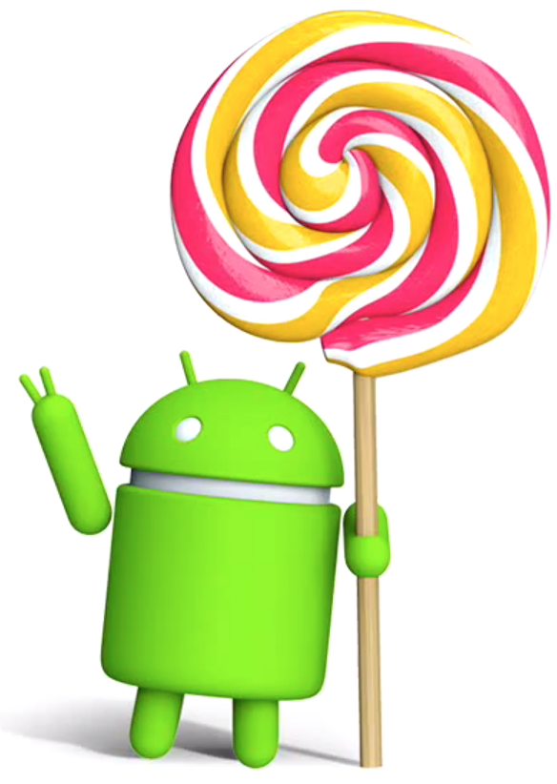
The Past
Android 5.0 (Lollipop)
Notes:
Smart lock began getting featured on devices, this meant that you could use your phone to unlock devices, that would normally require a password, by just standing near it with your mobile device.
An upgrade from the original 32 bit CPU, a 64 bit CPU began getting supported on lollipop devices, this would allow for more RAM (Random Access Memory) to be used on the phones, allowing them to be considerably faster and run more demanding applications.
Image from: http://androidadvices.com/android-version-name-lollipop/

Slide 13
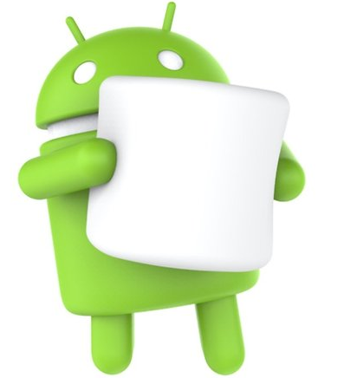
The Present
Android 6.0 (Marshmallow)
Notes:
The newest version of android (as of 01/12/2015) is marshmallow, not a lot has changed, the main display looks a bit more streamlined as well as introducing 4k display for apps. Some mobile devices come standard with a 4k camera as well to be able to view high quality video.
Doze was introduced as a battery saving feature, this meant when the mobile device was switched off, the phone would go into a doze, almost like standby, and help the phone reserve battery.
Image from: https://www.androidpit.com/android-marshmallow-update-overview-for-smartphones-and-tablets

Slide 14
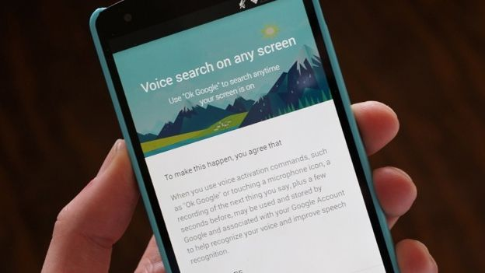

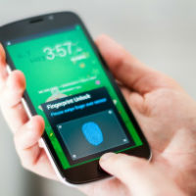

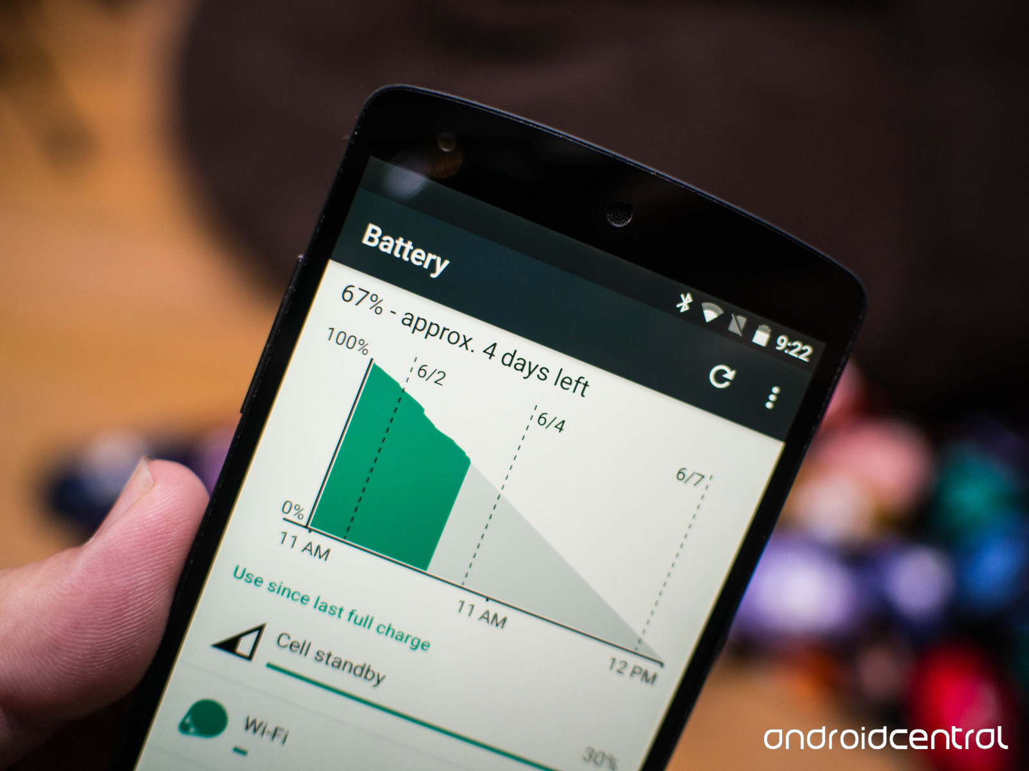
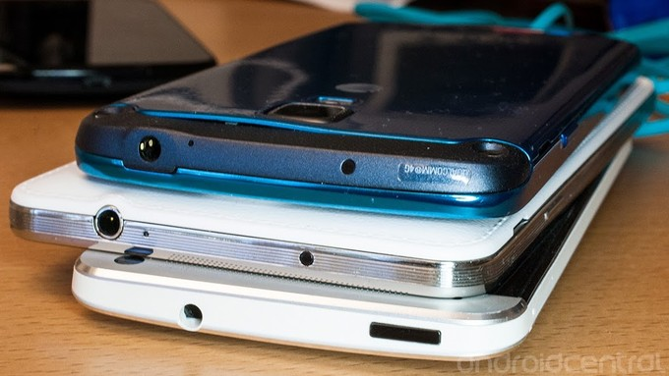
The Present
Notes:
Some notable android features that have been introduced lately are:
NFC to transfer data between android devices
IR Blaster to allow for smart remote through a smart device
Fingerprint scanners supported for easy unlock
Voice control with "Ok Google" able to search through phone files and internet
New 'Doze' feature for longer battery life (With marshmallow 6.0)

Slide 15
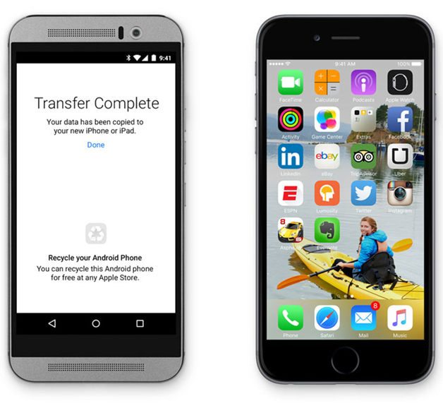
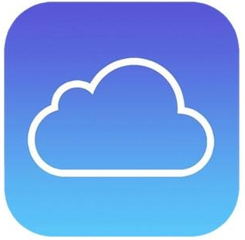

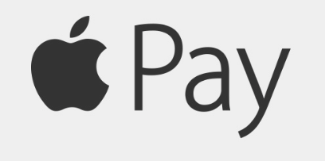


The Present
Notes:
Some notable IOS features that have been introduced lately are:
Apple Pay for easy pay
iCloud for backup
Siri easy search through phone and internet
Android Migration to transfer data from android to IOS
iSecurity is a new app introduced to help keep regular used passwords secure

Slide 16
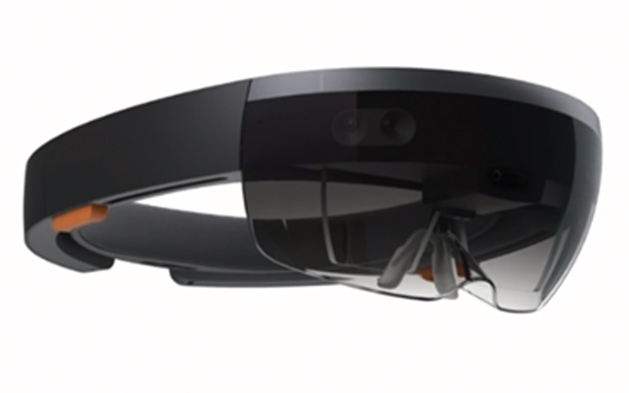
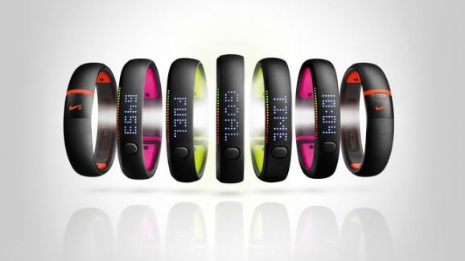
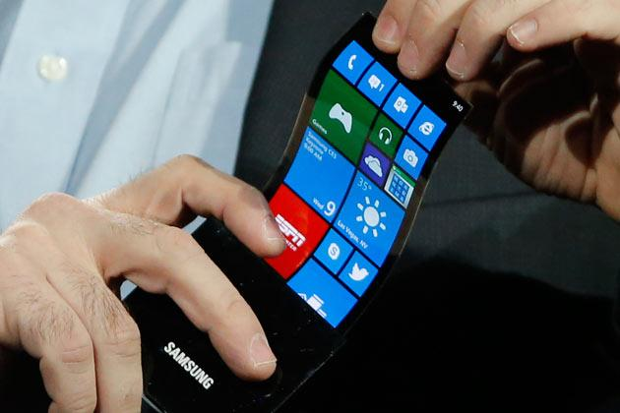
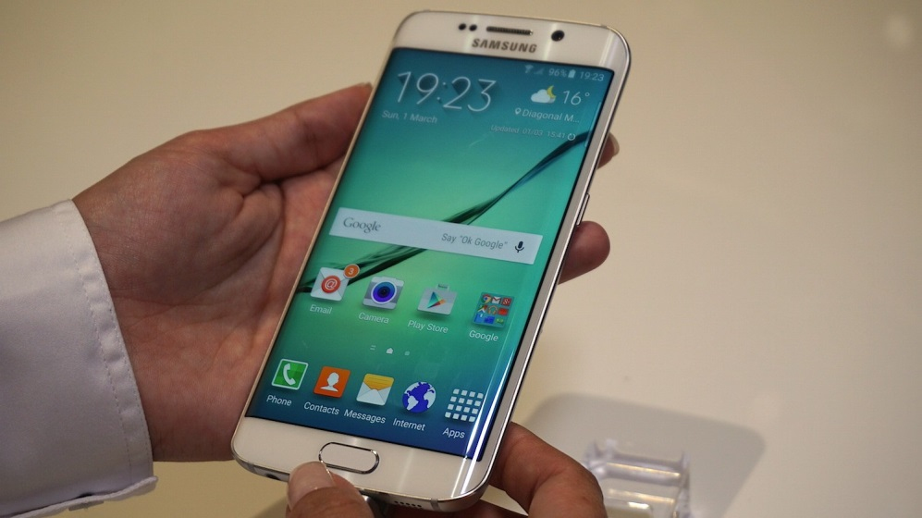
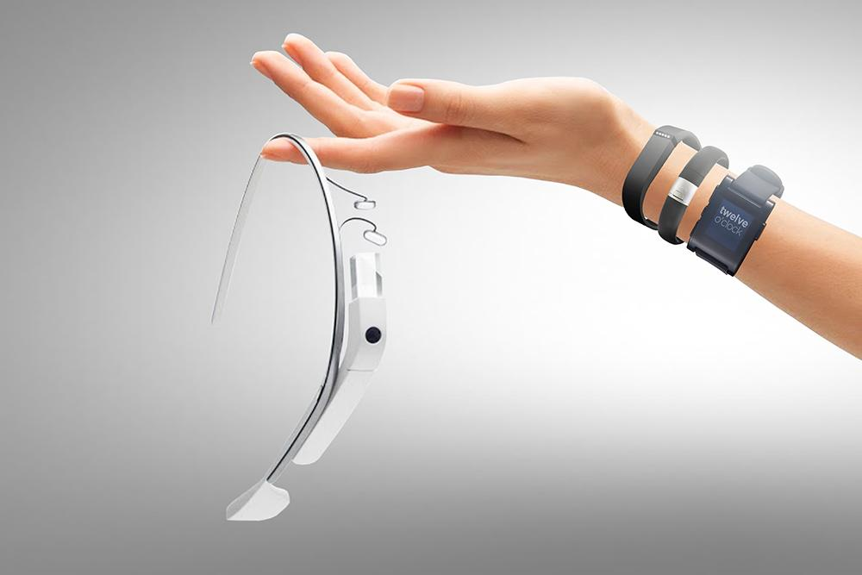
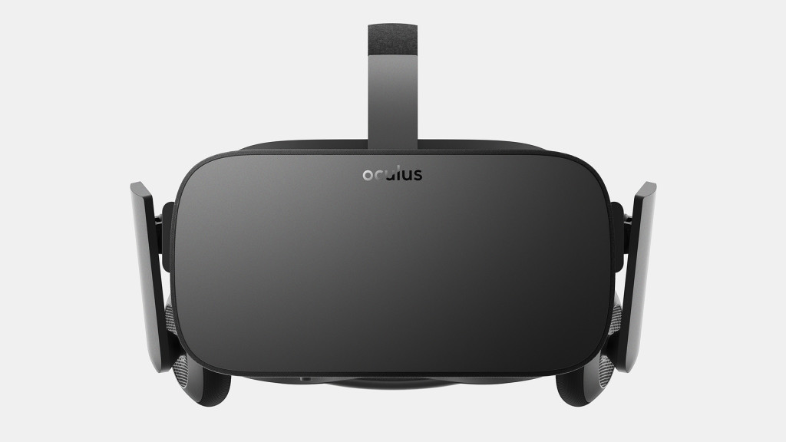
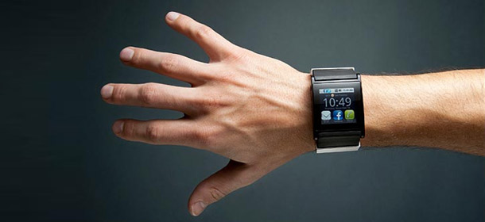
The Future
Next Year
Notes:
Oculus Rift
Holo Lens
Flexible Screens
Advanced Wearable Tech
Watches
Glasses
Fitness bands
Textured Screens

Slide 17
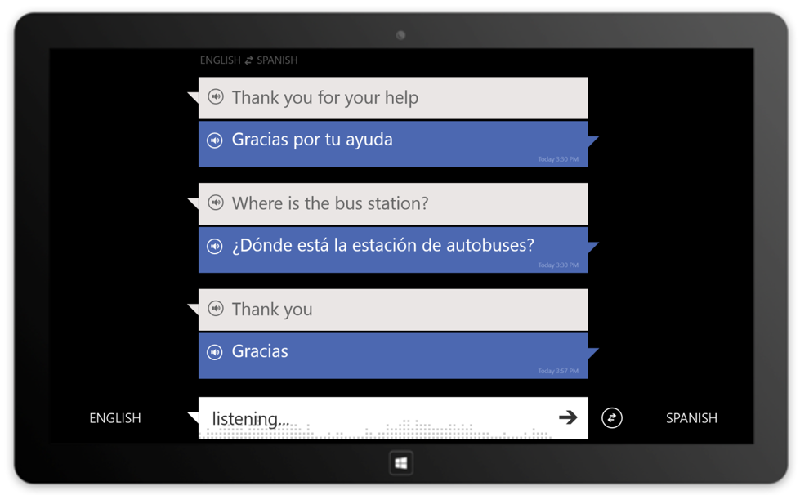
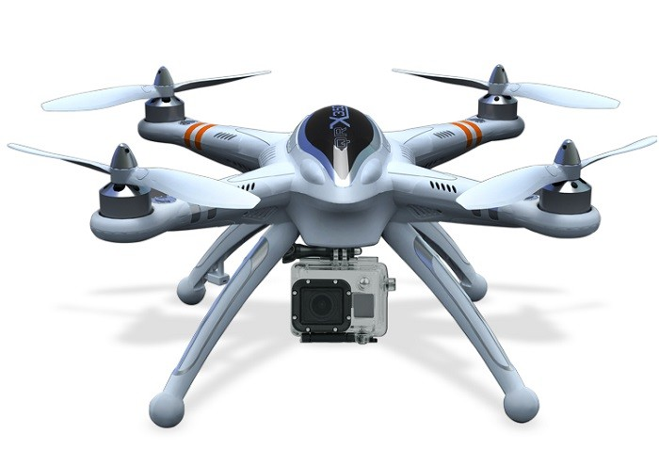
The Future
5 Years
Notes:
Advanced Drones
Speech to Speech Translation

Slide 18
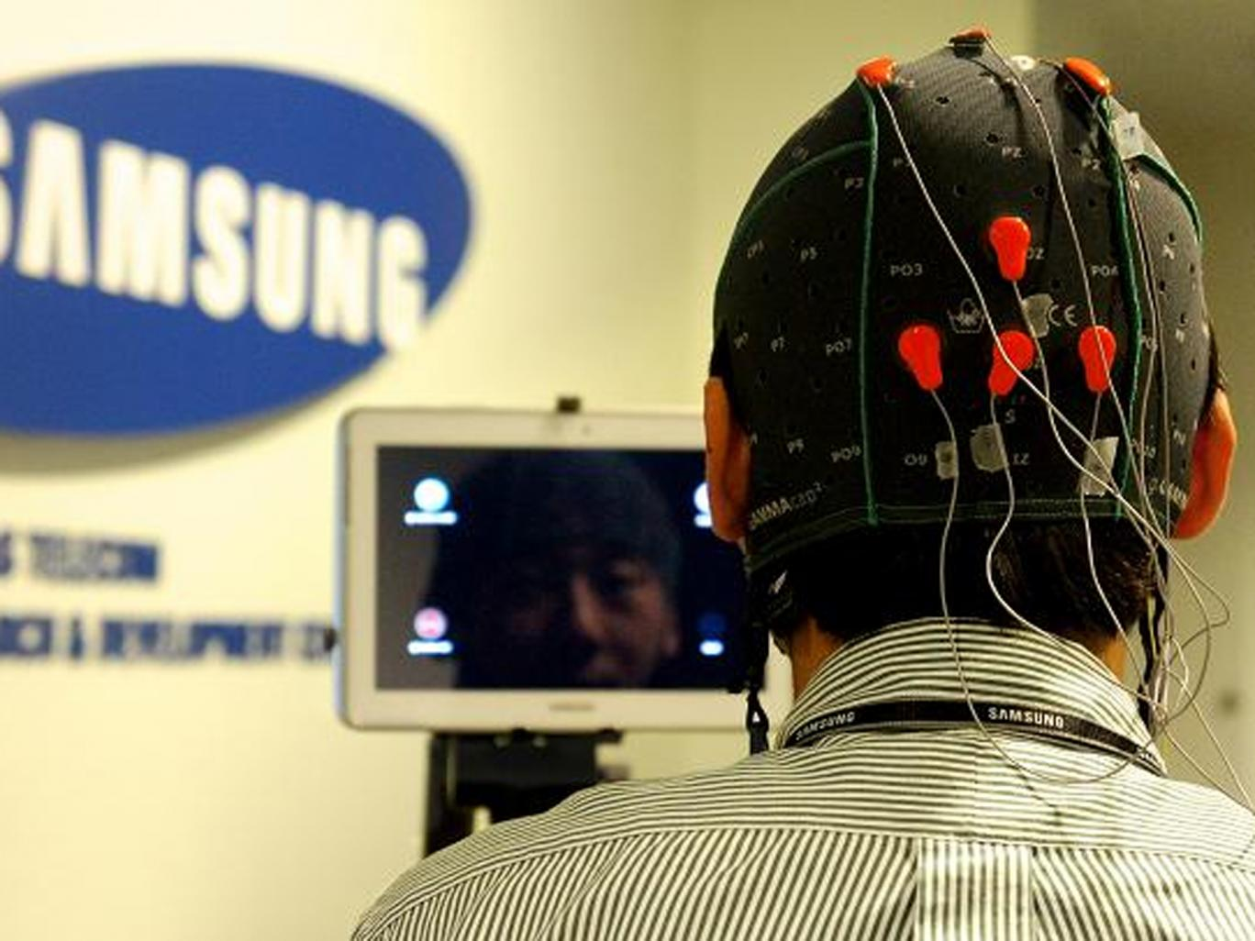
The Future
10 Years
Notes:
Mind Control (Using smartphone with mind)
Researchers at Samsung's Technology Lab are working an academic at the University of Texas to test how people can use their thoughts to launch an app, select a contact to call, choose a song on a playlist, and switch a device on or off
Link: http://www.independent.co.uk/life-style/gadgets-and-tech/news/introducing-the-mind-control-mobile-samsung-says-it-is-testing-smartphone-controlled-by-brain-waves-8588517.html

Slide 19

Any Questions?

